Slide 1
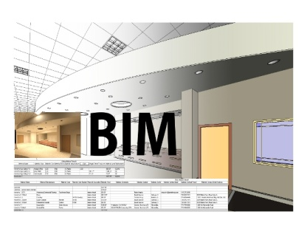

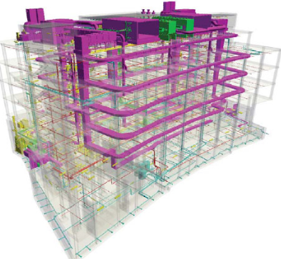
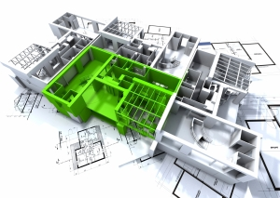
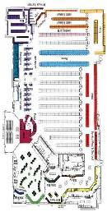
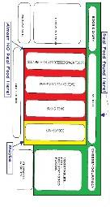
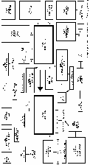
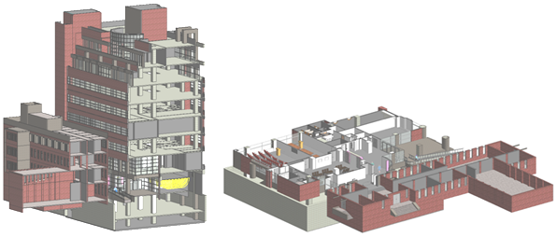
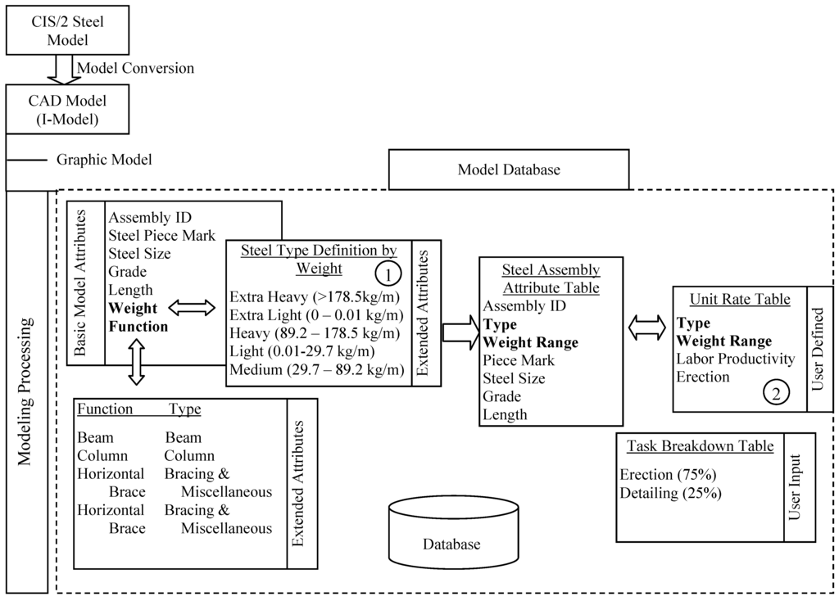
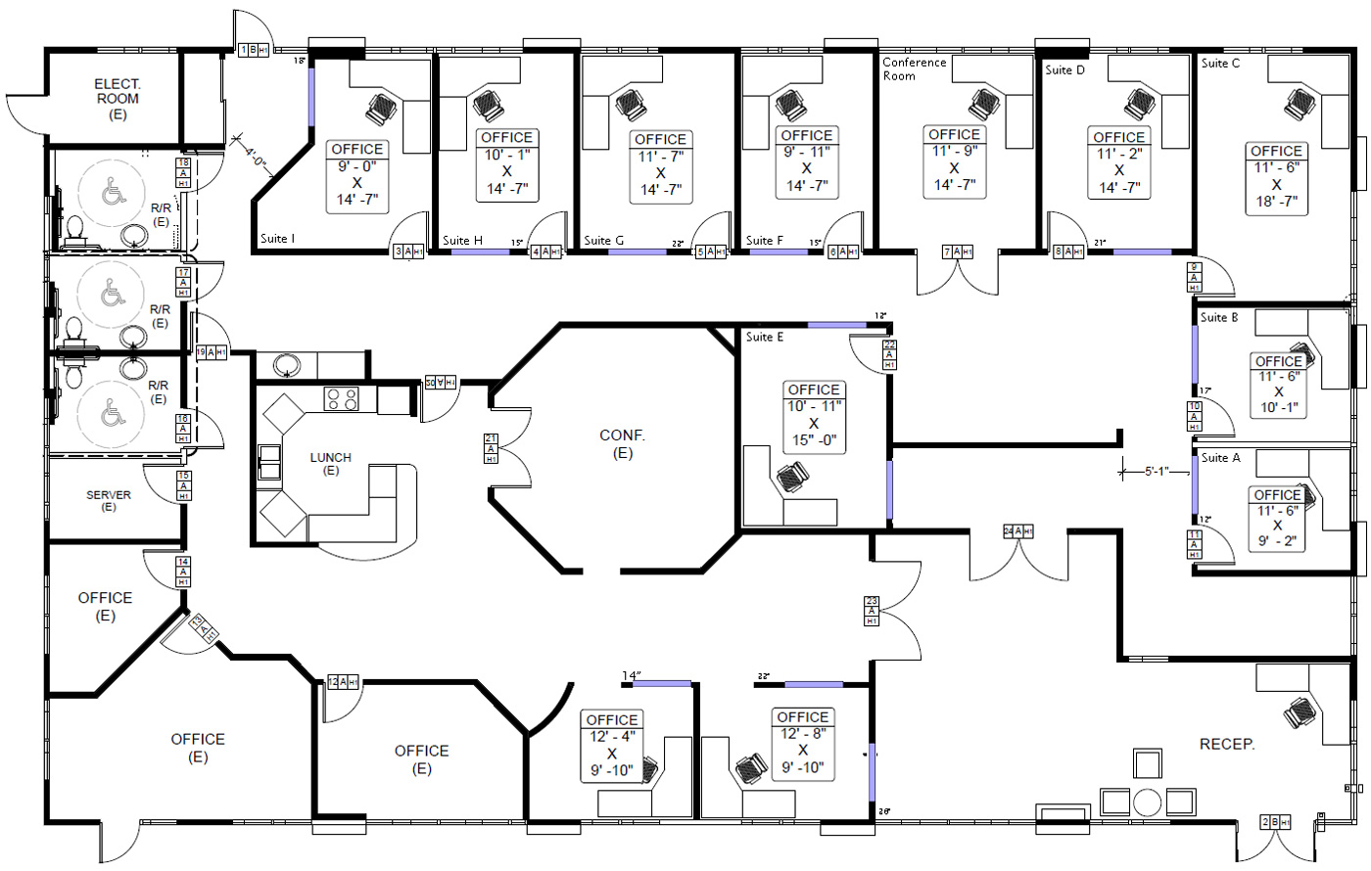
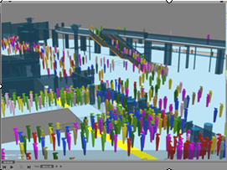
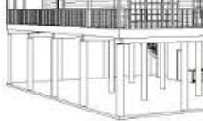
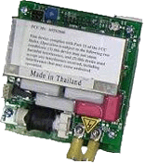
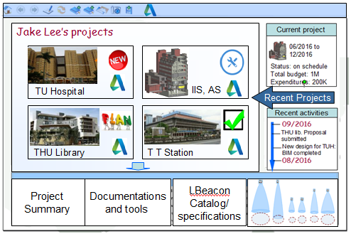

FM
Structure data
Spatial and floor plan data
BeDI repository
Geometric models
Exchange data
3
168
27
4
Notes:
Picture from http://www.marvelitech.com/images/data-maintenance-services/

Slide 2

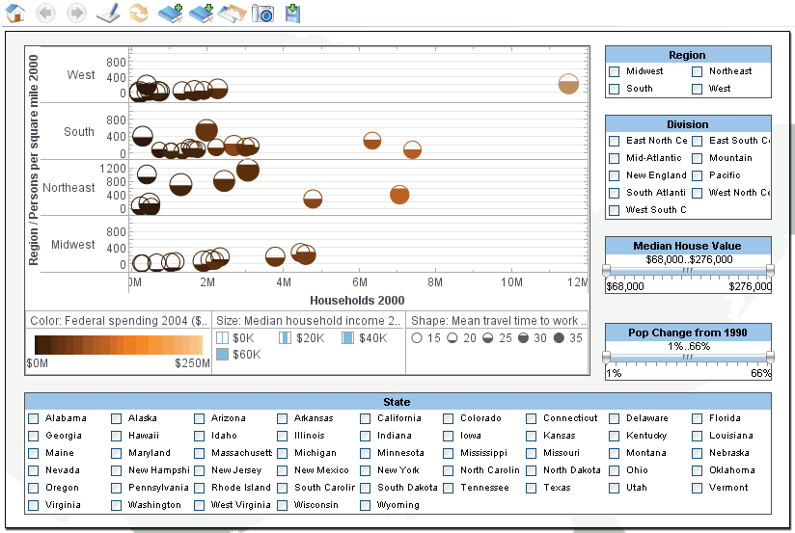

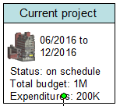
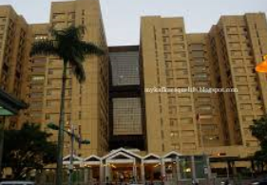

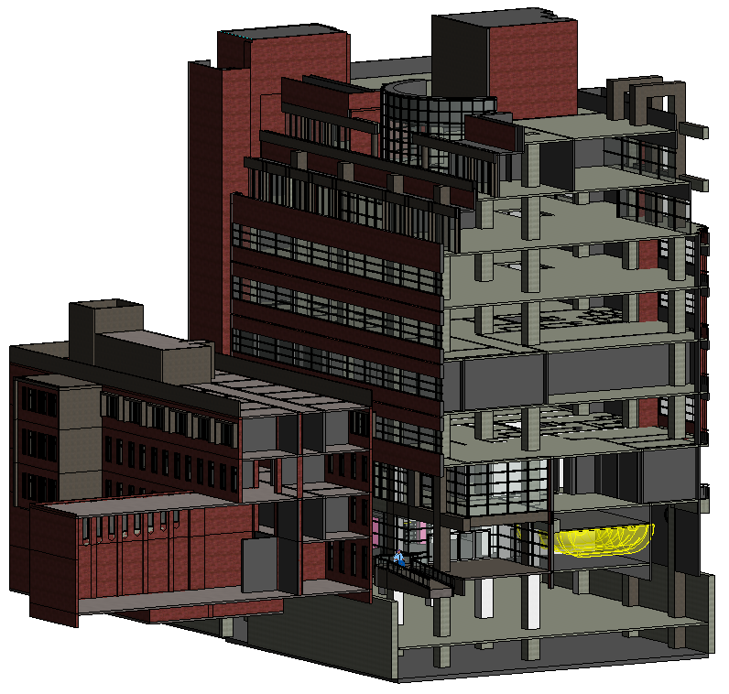

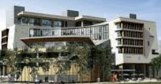

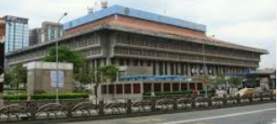

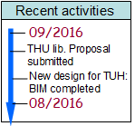
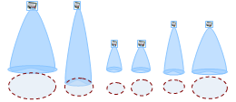
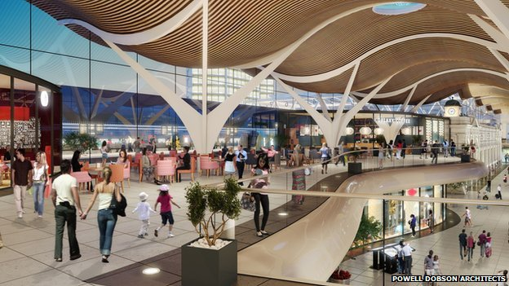
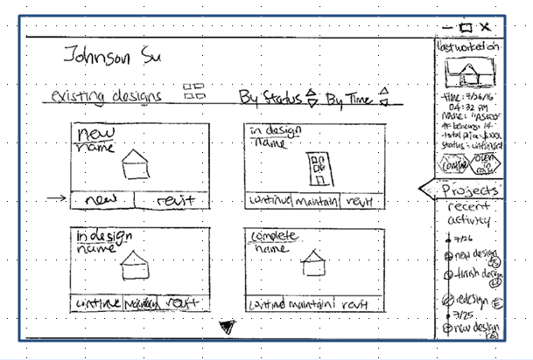
Jake Lee’s projects
TU Hospital
IIS, AS
Recent Projects
THU Library
T T Station
Project
Summary
Documentations
and tools
LBeacon
Catalog/
specifications

Slide 3
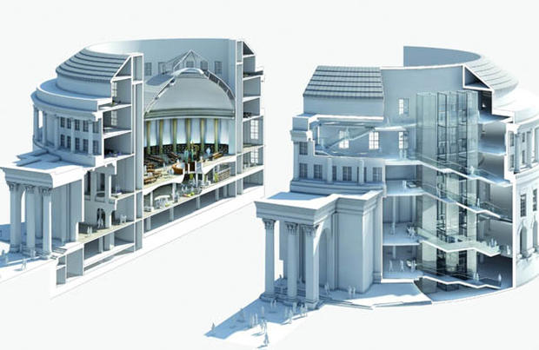
FM
BeDIC
Structure data
Spatial and floor plan data
2D-3D geometric models
Exchange data
Notes:
Picture from http://www.marvelitech.com/images/data-maintenance-services/

Slide 4
These 2D and 3D views of parts of the building are retrieved from the BeDIC of the building. They were produced during design and construction of the building and updated by the facility management system throughout the life time of the building. So are the 3D virtual reality model of the complex areas.
Our plugin provides models of Lbeacons of different ranges, antenna beam shapes, and coverage footprints. During the design process, the developer selects for each location in an area a beacon from the available types.

